Slide 1
A Practical Guide To Training RBM
From UTML 2010
-- 20130328

Slide 2
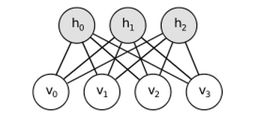
Overview

Slide 3

Collect statistics
Contrastive Divergence
The learning rule is much more closely approximating the gradient of another objective function called the Contrastive Divergence (Hinton, 2002) which is the difference between two Kullback-Liebler divergences
Compute hidden unit
Compare the value to random number between 0 and 1

Slide 4

Update visible states
Collecting statistics

Slide 5
Mini-batch methods
Divide the training set into small ‘mini-batches’.
Good to GPU boards or in Matlab
Avoid having to change the learning rate
Never make the mini-batch too large when using stochastic gradient descent.

Slide 6
Others tricks
Monitoring the progress of learning
Using the reconstruction error
Monitoring the learning rate
10^(-3) times the weights

